Slide 1
Week 3 Summary
KUL 4.0 IIoT
Jan van Deventer

Slide 2
Week Review
Subscribe and publish MQTT messages between IoT node and web browser via an MQTT broker at Amazon Web Service (IoT Core).
Authenticated and secured communication: Certificates and Keys

Slide 3
Beyond the week
This is a powerful development board
You can do a lot more with it
https://os.mbed.com/platforms/B-L4S5I-IOT01A/

Slide 4
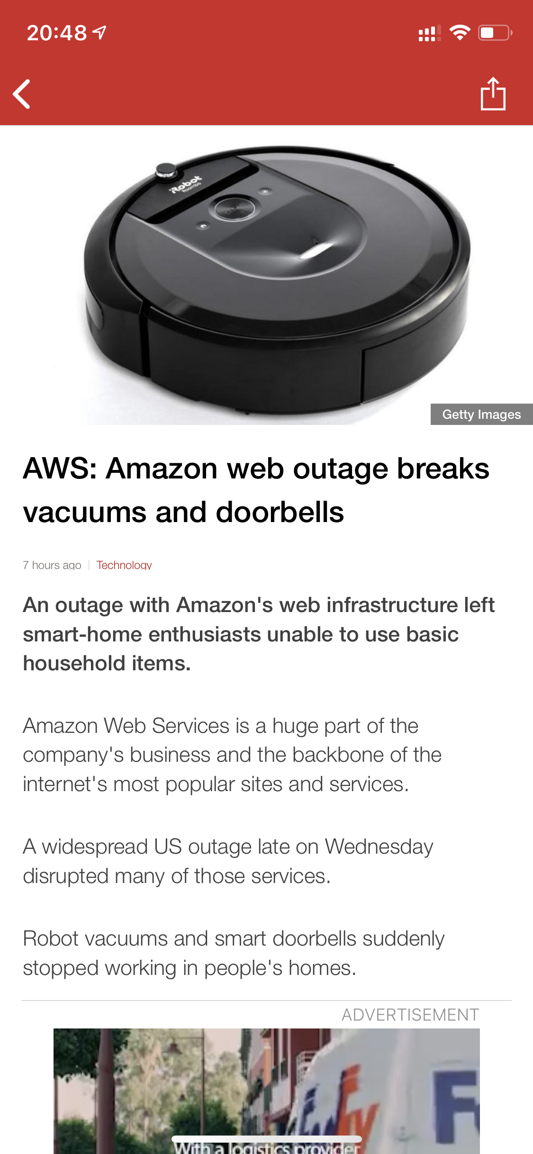
Close to Reality
The technology you used this week is in commercial products
The requirements of your solution must consider the implications of your choices
https://www.bbc.com

